Slide 1

Distributed System Lab (Week 3 )
Clock synchronization in a Distributed System
Department of Computer Science & Engineering
Motilal Nehru National Institute of Technology Allahabad
Prayagraj - 211004, India
September 2021

Slide 2
What is a Real Time System ?
A Real-time system is a computer system in which the correctness of the system behavior depends not only on the logical results of the computations but also on the time when the results are produced.
Real-time systems usually are in strong interaction with their physical environment. They receive data, process it, and return results in right time. E.g. A Distributed real time system.

Slide 3
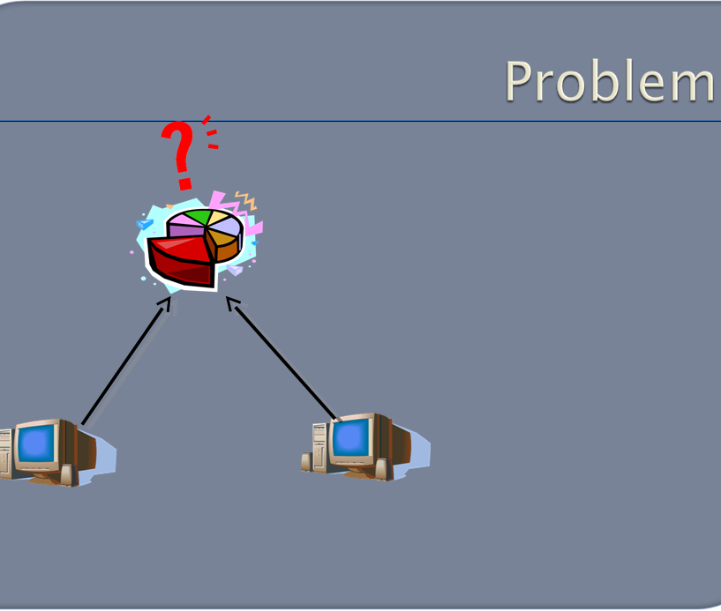
Q. WHICH REQUEST WAS MADE FIRST?
A common ‘Resource’
request A request B
Node A Node B
A Distributed System

Slide 4
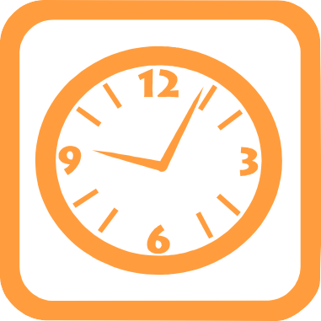
Q. WHICH REQUEST WAS MADE FIRST?
A common ‘Resource’
request A request B
A Global Clock ??
Global Synchronization?
Node A Node B
A Distributed System

Slide 5


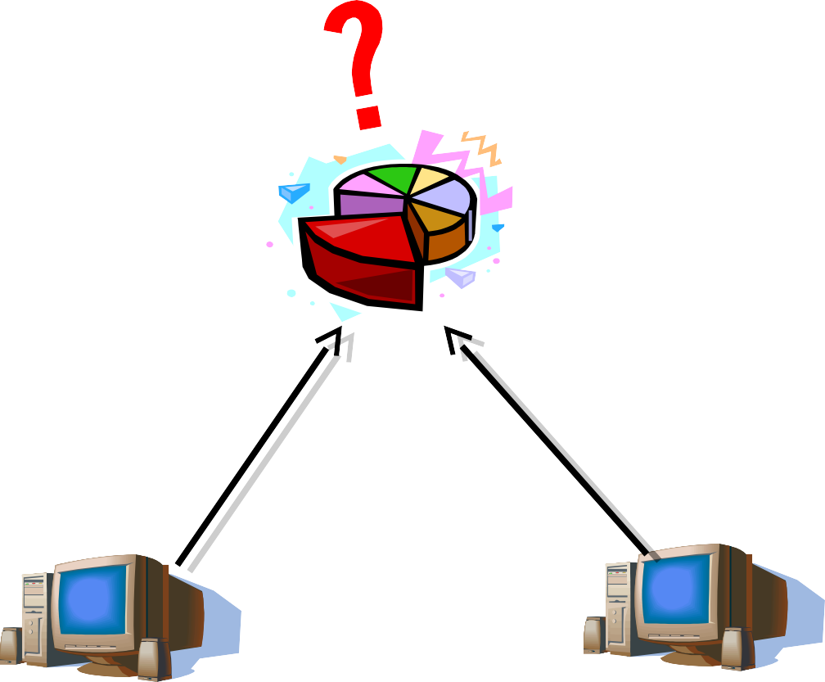


A common ‘Resource’
Q. WHICH REQUEST WAS MADE FIRST?
Solution ; Individual Clocks?
Are individual clocks accurate, precise?
request A request B
10:00 AM 10:02 AM
One clock might run faster/slower?

Slide 6
Drifting a Clock:
A quartz crystal oscillates at well deﬁned frequency and oscillations are counted (by hardware) in a register.
After a certain number of oscillations, an interrupt is generated; this is the clock tick.
At each clock tick, the computer clock is incremented by software.

Slide 7
Drifting a Clock (cont’d)..
The problems:
Crystals cannot be tuned perfectly. Temperature and other external factors can also inﬂuence their frequency.
Clock drift: the computer clock differs from the real time.
Two crystals are never identical.
Clock skew: the computer clocks on different processors of the distributed system show different time.

Slide 8
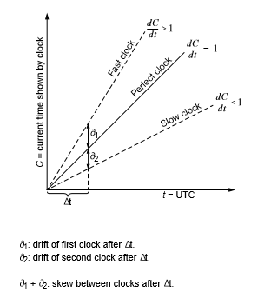
Drifting a Clock (cont’d)..

Slide 9
Clock synchronization in a Distributed System
NEED??
Time driven systems: in statically scheduled systems activities are started at "precise" times in different points of the distributed system.
Time stamps: certain events or messages are associated with a time stamp showing the actual time when they have been produced; certain decisions in the system are based on the "exact" time of the event or event ordering.
Calculating the duration of activities: if such an activity starts on one processor and ﬁnishes on another (e.g. transmitting a message), calculating the duration needs clocks to be synchronized.

Slide 10
Physical Clock
These are electronic devices that count oscillations occurring in a crystal.
Also called timer, usually a quartz crystal, oscillating at a well defined frequency.
Timer is associated with two registers: A Counter and a Holding Register, counter decreasing one at each oscillations.
Synchronizing Physical Clocks: done by two methods:
External Synchronization
Internal Synchronization

Slide 11
“UNIVERSAL” TIME
The standard for measurement of time intervals:
International Atomic Time (TAI): It deﬁnes the standard second and is based on atomic oscillators.
TAI - Temps Atomique International
Coordinated Universal Time (UTC): is based on TAI, but is kept in step with astronomical time (by occasionally inserting or deleting a "leap second").
UTC, Coordinated Universal Time, popularly known as GMT (Greenwich Mean Time)
UTC signals are broadcast from satellites and land based radio stations.
TAI is currently ahead of UTC by 37 seconds. TAI is always ahead of GPS by 19 seconds.

Slide 12
External synchronization
Synchronization with a time source external to the distributed systems, such as UTC broadcasting system.
One processor in the system (possibly several) is equipped with UTC receivers (time providers).
By external synchronization the system is kept synchronous with the "real time".
This allows to exchange consistently timing information with other systems and with users

Slide 13
Internal Synchronization
Synchronization among processors of the system.
It is needed in order to keep a consistent view of time over the system.
A few processors synchronize externally and the whole system is kept consistent by internal synchronization.
Sometimes only internal synchronization is performed (we don’t care for the drift from external/ real time).

Slide 14
Lack of Global Time in DS
It is impossible to guarantee that physical clocks run at the same frequency
Lack of global time, can cause problems
Example: UNIX make
Edit output.c at a client
output.o is at a server (compile at server)
Client machine clock can be lagging behind the server machine clock

Slide 15
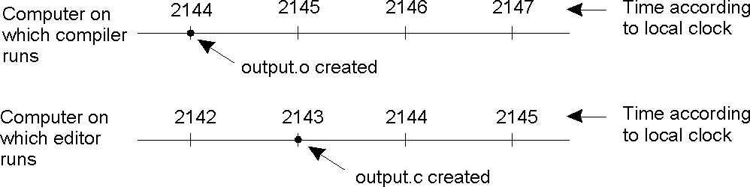
Lack of Global Time in DS
When each machine has its own clock, an event that occurred after another event may nevertheless be assigned an earlier time.

Slide 16
Logical Clocks

Slide 17

Assume no central time source –
Each system maintains its own local clock .
No total ordering of events .
Allow to get global ordering on events.
Assign sequence numbers to messages –
All cooperating processes can agree on order of event.

Slide 18
Logical clocks & concurrency
Assign “clock” value to each event
if a->b then clock(a) < clock(b)
since time cannot run backwards
If a and b occur on different processes that do not exchange messages, then
neither a-> b nor b -> a are true
These events are concurrent.

Slide 19

It is used to provide a partial ordering of events with minimal overhead.
It is used to synchronize the logical clock.
It follows some simple rules:
A process increments its counter before each event in that process i.e. Clock must tick once between every two events.
When a process sends a message, it includes its timestamp with the message.
On receiving a message, the receiver process sets its counter to be the maximum of the message counter and increments its own counter .

Slide 20
Happened –before Relation
a ‘Happened Before’ b : a→b
If a and b are events in the same process, and a comes before b, then a → b.
If
a :message sent
b : receipt of the same message then a → b.
Transitive: If a → b and b → c then a → c.
Two distinct events a and b are said to be concurrent if a -/->b and b -/->a

Slide 21
Event Counting example
Event counting example
 Three systems: P1, P2, P3
 Events a, b, c, d,…
 Local event counter on each system
 Systems occasionally communicate

Slide 22
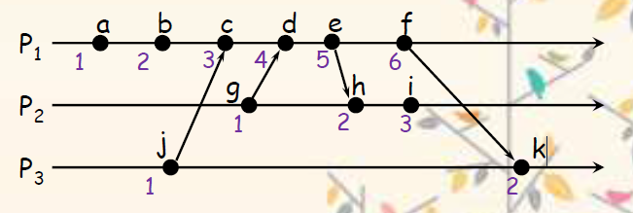
Event Counting example
Bad ordering:
e ->h
f ->k

Slide 23
Lamport’s algorithm
Each message carries a timestamp of the sender’s clock
When a message arrives:
if receiver’s clock < message timestamp
set system clock to
(message timestamp + 1)
else do nothing
Clock must be advanced between any two events in the same process

Slide 24
Lamport’s algorithm
Algorithm allows us to maintain time ordering among related events
Partial ordering
Partial ordering of events by occurrence
Causally Related Events
If event A happens before event B, then A causally affects B.
Concurrent Events
Two distinct events A and B are concurrent if A does not happen before B and B does not happen before A. That is, the events have no causal relationship

Slide 25
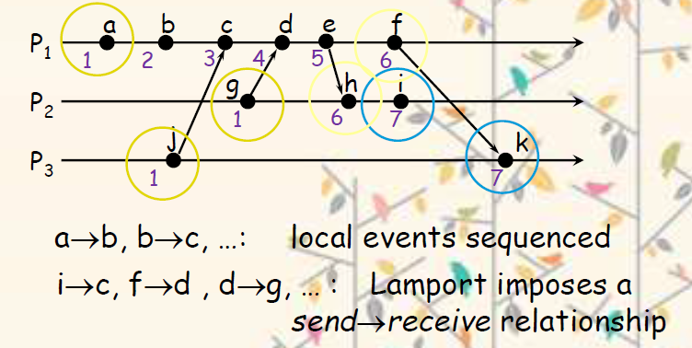
Problem: Identical timestamps
Concurrent events (e.g., a & i) may have the same timestamp … or not.

Slide 26

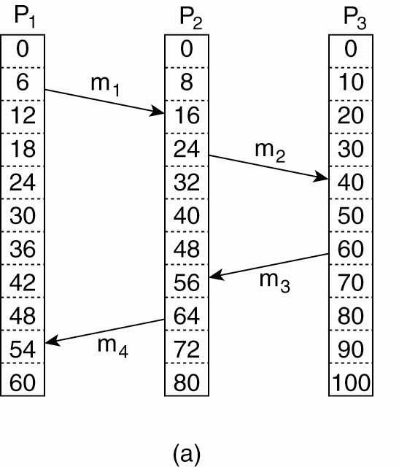

Slide 27
Lamport’s Logical Clock
Three processes, each with its own clock.
The clocks run at different rates.

Slide 28

For two events a and b in same process p1
 C(b)= C(a)+1
If a is sending process and b is receiving process of pi and pj then,
 Cj(b)=max((Ci(a)+1),Cj(b))

Slide 29

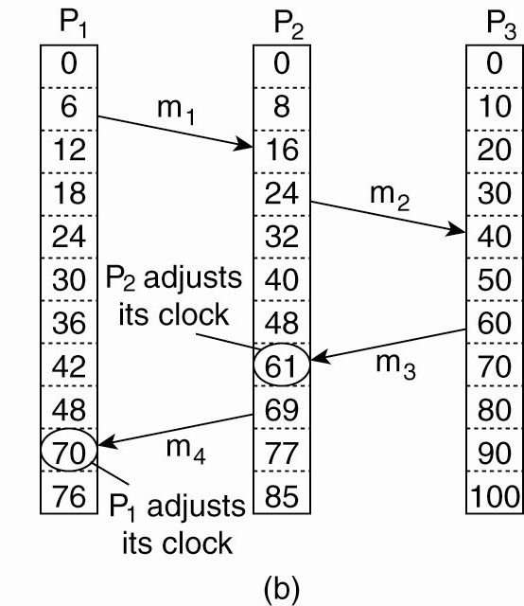

Slide 30
Thank You

